Slide 1



Cellular Automata based Entrepreneurial Growth Model
Cecilia E. Nugraheni & Vania Natali
Dept. of Computer Science – Parahyangan Catholic University – Bandung - Indonesia

Slide 2
Introduction
GEM’s Entrepreneurship Model
Entrepreneurial Cellular Automata
Simulation
Conclusion
Outline
Notes:
© Copyright Showeet.com

Slide 3

Introduction

Slide 4
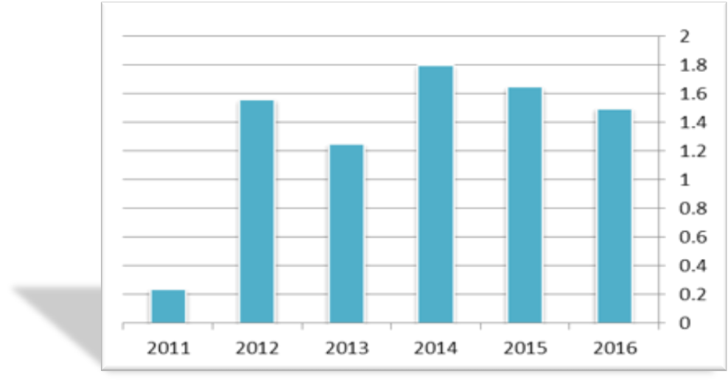
Entrepreneurship
Entrepreneurship is understood as the application of creativity and innovation to solve problems and efforts to exploit the opportunities faced by people every day.
People who engage in entrepreneurial activity are called entrepreneurs.
Entrepreneurship plays an important role in the economic growth of a country.
Ideally, the size of the entrepreneurial population is 2% of the total population of a country.
Indonesia Entrepreneurial population

Slide 5



Entrepreneurship monitoring - 1
Entrepreneurship should be maintained and monitored by the government or private institutions, for example GEM (Global Entrepreneurship Monitoring):
established in 1997 by Michael Hay of London Business School (LBS) and Bill Bygrave of Babson College;
aims to measure and to monitor entrepreneurial activities by using a holistic perspective;
measures entrepreneurship in many countries;
provides data freely www.gemconsortium.org.

Slide 6
Entrepreneurship monitoring – 2
Monitoring process can be conducted in two ways:
direct
Monitoring the real condition.
indirect
Modeling & simulation approach
Entrepreneurship condition is represented as a mathematical model and then simulation on the model.
To learn the behavior of entrepreneurship and to predict the future based on the current condition.

Slide 7
Cellular automata – 1
First introduced by Ulam and von Neumann in 1940.
A mathematical model used to study the behavior of complex systems.
A CA consists of a set of cells
The cells are arranged in arrays (grids).
Each cell has one of a number of possible states.
The state may change according to certain rules.
The state change of a cell is influenced by the state of the surrounding cells (neighbors).
t=0
t=1
t=2
t=3
t=4

Slide 8
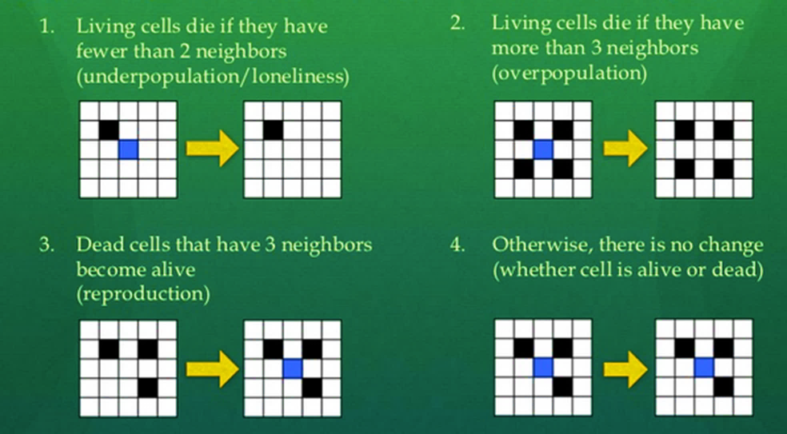
Cellular automata – 2
Another type of CA: 2-D CA (game of life).
CA applications:
computing [1],
transportation [2][3],
health [4][5],
social science [6][7],
etc.

Slide 9
OBJECTIVE & METHODOLOGY
Develop a cellular automata based model for monitoring entrepreneurial growth.
Model development
Problem analysis
Model definition
Model Validation
Simulation on real data sets.
Model Refinement
More parameters
Simulation on dummy data

Slide 10

GEM’s EntrePreneurship Model

Slide 11
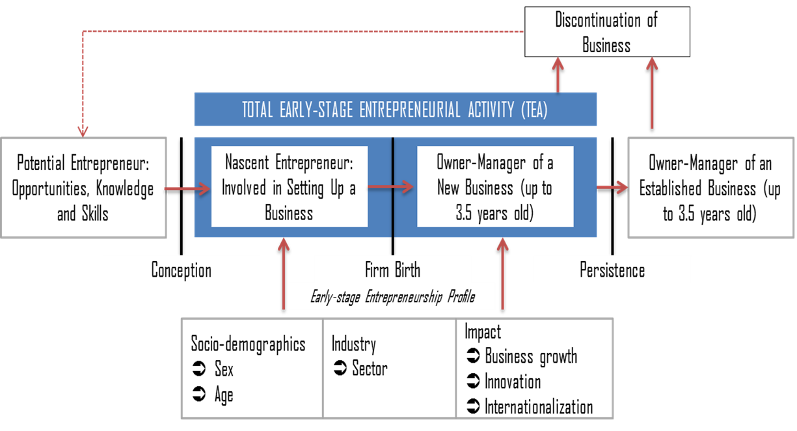

Slide 12
Entrepreneur attributes – 1
General Attributes
Special attributes
Gender
Age
Business category
Location
Entrepreneurial level (potential, nascent, new business manager, established business manager, retired)
Perceived opportunities
Perceived capabilities
Entrepreneurial intention
Fear of failure

Slide 13
Entrepreneur attributes – 2
Static Attributes
Non-static attributes
Gender
Business category
Location
Age
Entrepreneurial level
Business age

Slide 14

Entrepreneurial Cellular Automata

Slide 15
Main Components
ECA is an extension of standard CA.
Cells
Entrepreneurs
Grids
More like graphs
State
Comprised of several attributes
Neighborhood: single – static
Neighborhood: multiple & dynamic

Slide 16
State Transition Function – 1
Entrepreneurial level as main reference.
Continuity Index (Cidx)
A number that indicates the possibility of an entrepreneur to continue his/her business.
CIdx is determined by internal factors and external factors (neighborhood – other entrepreneurs) and from outside (public) world like government policy, economic condition, etc.
a, b, c are real numbers such that 0 ≤ a, b, c ≤ 1 and a + b + c = 1.0.
CIdx_{i} (t) = a.Cint_{i}(t) + b.Cneg_{i} (t) + c.Cpub(t)

Slide 17
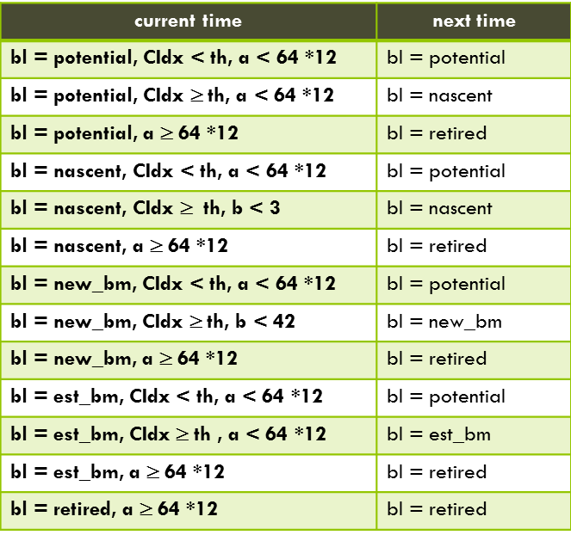
State Transition Function – 2
An entrepreneur will continue his business if the CIdx meets a certain threshold.

Slide 18
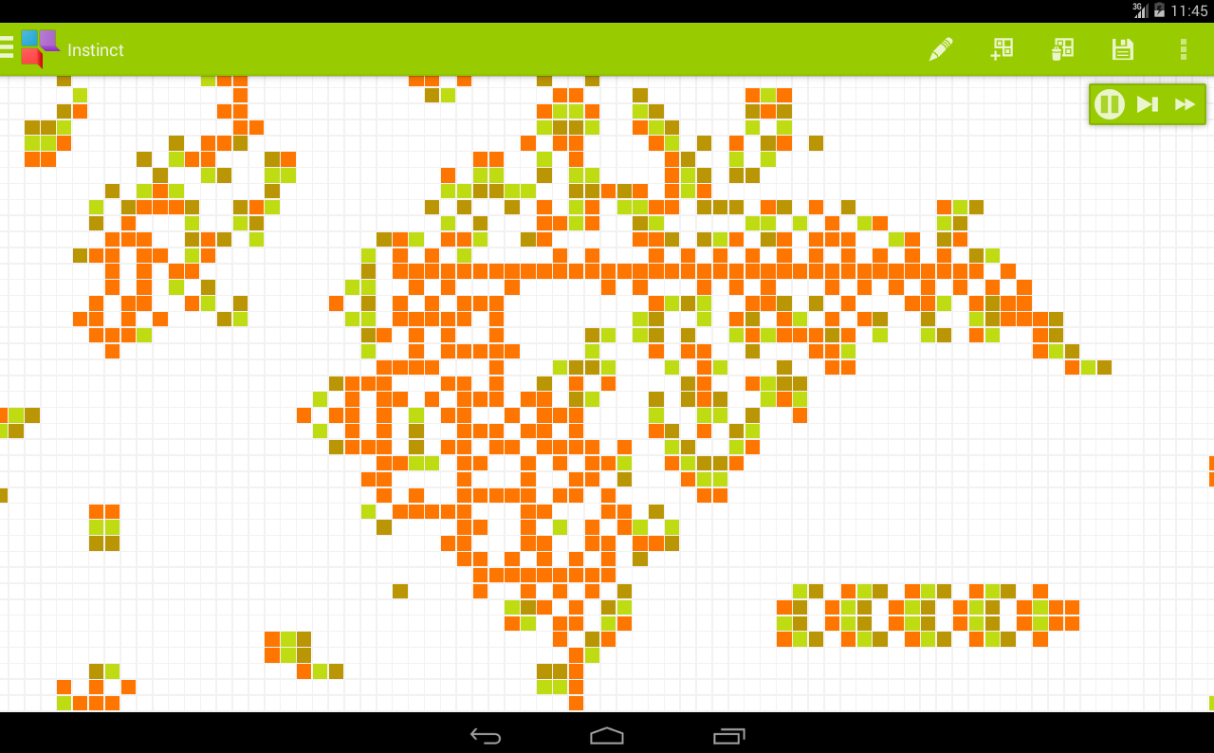
Simulation

Slide 19
Data
1000 entrepreneurs.
Female : male = 60 % : 40 %.
Age group composition
Entrepreneurial level composition
Public factors and attribute values refer to Gem 2013 Indonesia Report [10].
age | potential | nascent | new_bm | est_bm | retired
18-24 | 70% | 20% | 10% | 0% | 0%
25-34 | 60% | 25% | 10% | 5% | 0%
35-44 | 45% | 15% | 20% | 20% | 0%
45-54 | 25% | 30% | 20% | 25% | 0%
55-64 | 10% | 10% | 30% | 50% | 0%
65-… | 0% | 0% | 0% | 0% | 100%
age | %
18-24 | 20
25-34 | 20
35-44 | 20
45-54 | 20
55-64 | 15
65-… | 5

Slide 20
Objectives
Parameter
How the model works
The effects of a,b,c composition
The effect of threshold
Simulation | a | b | c | threshold
1 | 0.7 | 0.2 | 0.1 | 20
2 | 0.6 | 0.3 | 0.1 | 20
3 | 0.5 | 0.4 | 0.1 | 20
4 | 0.5 | 0.3 | 0.2 | 20
5 | 0.5 | 0.3 | 0.2 | 15
6 | 0.5 | 0.3 | 0.2 | 10

Slide 21
Simulation 1
Simulation 2
Simulation 3
Simulation 4
Simulation 5
Simulation 6
The greater the influence of neighbors, the slower the growth of entrepreneurship.
Established business manager growth is inversely proportional to the threshold value.
Simulation 4

Slide 22

Conclusion

Slide 23
Conclusions
We have developed a mathematical model that can be used to monitor entrepreneurial growth.
ECA is an extension of standard CA. The extension includes the neighborhood, state transition function, and neighborhood transformation function.
This model has been implemented in a computer program and by using this program some simulations have been conducted.
It is planned to consider more parameters like Entrepreneurial Intentions (EI), the population growth either, and conduct simulations on some real data sets.

Slide 24
References
[1] N. Ganguly, B.K. Sikdar, A. Deutsch, G. Canright, P.P. Chaudhuri. (2003). A survey on cellular automata. Technical report Centre for High-Performance Computing Dresden University of Technology.
[2] K. Bentaleb, K. Jetto, H. Ez-Zahraouy, A. Benyoussef. (2013). A cellular automata traffic flow modeling of desired speed variability. Chinese Physics B, Volume 22, Number 1.
[3] I. Kurnaz (2016). Urban Traffic Modeling With Microscopic Approach Using Cellular Automata. Tehnički vjesnik 23, 6(2016), 1565-1570.
[4] P. Eosina, T. Djatna, H. Khusun. (2016). A Cellular Automata Modeling for Visualizing and Predicting Spreading Patterns of Dengue Fever. TELKOMNIKA (Telecommunication Computing Electronics and Control) 14 (1), 228-237.
[5] Senthil Athithan, et.al. (2014). Dynamic Cellular Automata Based Epidemic Spread Model for Population in Patches with Movement. Journal of Computational Environmental Sciences, vol. 2014, Article ID 518053, 8 pages, 2014. doi:10.1155/2014/518053.
[6] Engelen, G., White, R., Van der Meulen, M., & Hahn, B. (2002). Sustainable developments of islands: a policy support framework for the integrated assessment of socio-economic and environmental development. In H.-H. M. Hsiao, C.-H. Liu, & H.-M. Tsai (Eds.), Sustainable development for island societies: Taiwan and the world.
[7] Nowak A., Lewenstein M. (1996) Modeling Social Change with Cellular Automata. In: Hegselmann R., Mueller U., Troitzsch K.G. (eds) Modelling and Simulation in the Social Sciences from the Philosophy of Science Point of View. Theory and Decision Library (Series A: Philosophy and Methodology of the Social Sciences), vol 23. Springer, Dordrecht.
[8] N. Yu, M. Li, X. Ruan. (2005) Applications of Cellular Automata in Complex System Study. International Journal of Information and Systems Sciences. Vol 1. No. 2-3, pp. 302-310.
[9] J. Ding (2011). Cellular Automata based Artificial Financial Market, Cellular Automata - Simplicity Behind Complexity, Dr. Alejandro Salcido (Ed.), InTech, DOI: 10.5772/15805. Available from: https://www.intechopen.com/books/cellular-automata-simplicity-behind-complexity/cellular-automata-based-artificial-financial-market.
[10] C.B. Nawangpalupi, G. Pawitan, A. Gunawan, M. Widyarini, T. Iskandarsjah. (2014) Global Entrepreneurship Monitor 2013 Indonesia Report.

Slide 25
Thank You!
Notes:
© Copyright Showeet.com

